Slide 1
Order R1-2017-0031 Scott River TMDL Conditional Waiver of Waste Discharge Requirements and Order R1-2017-0032 Shasta River TMDL Conditional Waiver of Waste Discharge Requirements Item No. 5
North Coast Regional Water Quality Control Board
Eli Scott
June 29, 2017; Santa Rosa, CA

Slide 2
Topics
Overall water quality approach.
Scott and Shasta River waiver conditions and progress to date.
Proposed changes in the draft waivers.
Implementation approach.
Adoption timeline.

Slide 3
Water Quality Approach
Based on 303(d) listing and TMDL Action Plans.
Considers multiple dischargers and multiple permitting programs.
Waiver provides a regulatory tool. Prior to waiver there was no permitting tool for these discharges.
Builds a coordinated approach towards comprehensive watershed restoration.
Cultivates partnerships between agencies, community groups, stakeholders, funders, land owners.

Slide 4
Summary of Scott River TMDL Action Plan
Scott River TMDL Action Plan:
Adopted by the Regional Board on December 7, 2005.
Temperature and sediment TMDL analysis summary.
Focuses on riparian shade, water management, erosion control.
Action plan Identifies:
Actions necessary to achieve the TMDL and water quality objectives, by topic.
Parties responsible for implementing the identified actions (Dischargers).
Monitoring and reporting requirements.

Slide 5
Summary of Shasta River TMDL Action Plan
Shasta River TMDL Action Plan:
Adopted by the Regional Board on June 26, 2006.
Temperature and dissolved oxygen TMDL analysis.
Focuses on riparian condition and tailwater impacts.
Action Plan Identifies:
Actions necessary to achieve TMDL and water quality objectives .
Parties responsible for implementing the identified actions (Dischargers).
Monitoring and reporting requirements.

Slide 6
Conditions of the Existing Scott River and Shasta River TMDL Waivers (Order R1-2012-0083 and Order R1-2012-0084)
Employ land stewardship practices that “minimize, control and preferably prevent the discharge of pollutants”.
Allow RWB staff reasonable access to property to evaluate compliance.
Submit plans and/or other documentation if requested by Executive Officer.
Ranch Management Plan.
Grazing Management Plan.
Tailwater Management Plan.
Erosion Control Plan.

Slide 7
Progress In the Shasta
In concert with grant programs, waivers and stewardship partners:
24 stock water systems installed.
8 irrigation efficiency projects.
6 tailwater diversion project.
3,750 linear feet of riparian plantings.
23 Ranch assessments.
133 miles of riparian fencing.
61% of the entire Shasta River system fenced.
Compelling water quality trends.

Slide 8
Progress in the Scott
In concert with grant programs, waivers and stewardship partners:
11 acres of Riparian plantings.
6 Beaver Dam Analogues installed.
4 major bank stabilization projects.
16 ranches assessed.
33% of the total stream frontage.
UC Davis developed comprehensive groundwater model to test scenarios that increase summer instream flow.

Slide 9
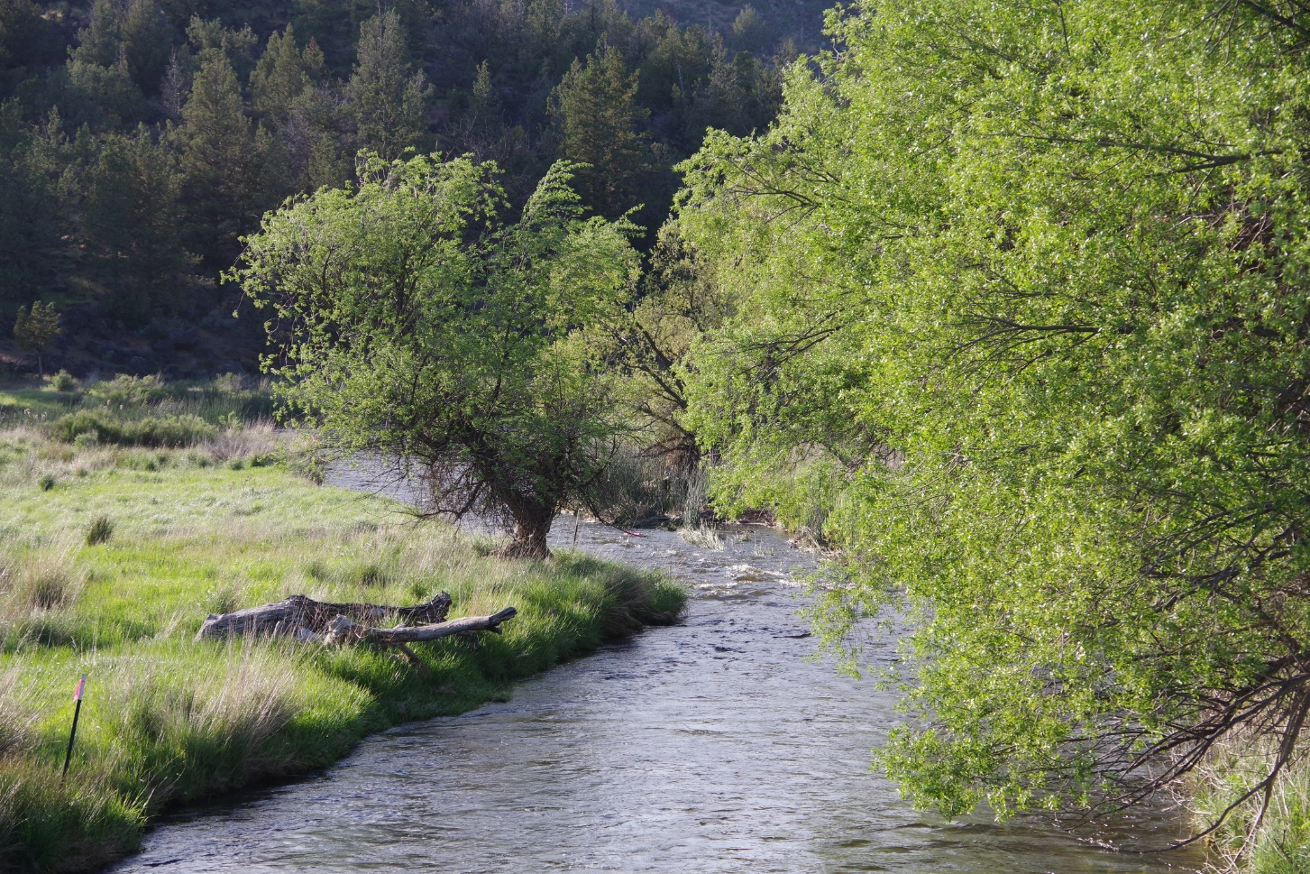
Shasta River Approach

Slide 10
Tailwater Neighborhood Ranking (Aquaterra and SVRCD, 2013)

Slide 11
Adapt to Emerging Trends
Continue efforts on identified cold water refugia and coho habitat areas downstream of Dwinnell Dam, Big Springs Creek and Parks Creek.
Continue approach of not requiring enrollment, focusing staff time on high priority areas.
Utilize data analyzed and presented in the Shasta Watershed Stewardship report to refine best practice recommendations.
Track water quality improvements over time to refocus on areas that are not showing improving WQ trends.

Slide 12
Scott River Approach

Slide 13
Prioritizing Based on Risk
Relies on property-by-property assessments of water quality protection.
Prioritize properties for waiver compliance assessments based on the length of streams on a property adjacent to farming and ranching activities.

Slide 14
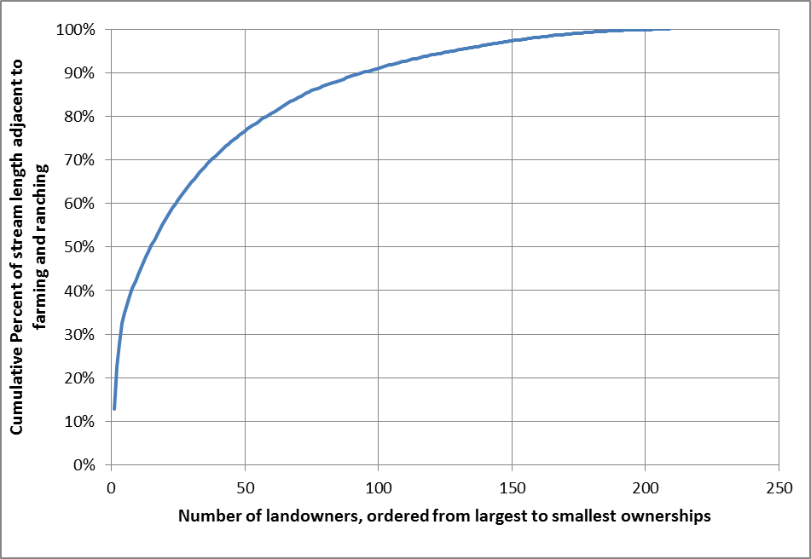
Prioritizing Based on Risk
An analysis of properties with farming and/or ranching activities adjacent to streams indicates:
Half the stream length in this category is owned by 15 landowners.
90% of the stream length is owned by 96 landowners.
(96, 90%)
Information sources:
County assessor’s parcel data.
DWR land and water use assessment data.
Hydrography.
(15, 50%)
~33% Assessed

Slide 15
Confluence of French Creek and Scott River June 3, 2003

Slide 16
Confluence of French Creek and Scott River August 23, 2016

Slide 17
Summary of Draft Conditional Waiver Programs (Order R1-2017-0031 and Order R1-2017-0032)
Extends existing waiver provisions for five years:
Allows Regional Water Board staff property access for water quality assessment purposes.
EO can require preparation of plans and effectiveness monitoring.
Continues staff’s focused efforts in high opportunity restoration areas in the Shasta and high priority ranches in the Scott, utilizing ongoing monitoring data to refine management approach.
Focuses on incentivizing cooperation while supporting appropriate accountability.
Recognizes progress made since adoption of the TMDL action plans.

Slide 18
New Contents of the Draft Conditional Waivers
Specific requirements for Management Measures to minimize, control, or prevent the discharge of substances that increase risk to water quality.
Alternative measures are acceptable if they provide equal or better water quality protection.
Alternative measures may be developed with prior consultation with Regional Water Board staff.
Practices addressing chemical fertilizers, pesticides, fuels, oils and other potentially hazardous substances.
Clarify requirements related to:
Management plans.
Monitoring plans.

Slide 19
New Contents of the Draft Conditional Waivers
Forecasts possible changes to next waiver renewal:
Enrollment.
Tiered permit requirements based on threat to water quality.
Fees.
Operations already in compliance with this waiver may face a de minimis “stewardship” level tier.
These changes would be considered for the next renewal in 2022, and would be subject to a separate public comment process

Slide 20
Waiver Implementation Approach

Slide 21
Waiver Implementation Approach
Efforts to implement the waiver conditions will be focused in the following categories:
Properties meeting risk criteria.
Water quality issues identified through complaints.
Areas with unique opportunities to improve water quality.

Slide 22
Waiver Implementation Approach: Approaching landowners
Initial Steps:
Contact landowner (usually by phone) and arrange a mutually agreeable assessment date.
Review and discuss the waiver.
Assess and evaluate management practices and water quality protection measures.
Inform the landowner of program requirements and assistance programs.

Slide 23
Waiver Implementation Approach: Assessing Compliance
Identify areas with practices protective of water quality or need improvement and discuss with landowners.
Verify waiver coverage, or identify necessary plans to attain compliance, as appropriate.
Document outcome in a letter.

Slide 24
Waiver Implementation Approach: Assessing Compliance
Evaluate the need for plans and monitoring on a case-by-case basis, using a consistent assessment approach.
Focus assessments on factors related to discharge of nutrients, sediment, and/or elevated solar radiation loads:
riparian conditions.
livestock access to riparian areas.
potential discharge of eroded sediments.
the potential for tailwater discharge.

Slide 25
Waiver Implementation Approach: Plan Requirements
The Executive Officer will require a plan and/or other documentation to address corrective actions in the following situations:
Landowner needs additional time to identify a remedy.
If the corrective actions require specific expertise.
Staff are unable to come to agreement with the landowner at the time of assessment.

Slide 26
Scope of Plans
Plans will be specified in writing and will span a range of situations:
Simple plan: description of practices implemented to prevent discharges; or
Comprehensive Plan: an inventory of existing sources of sediment discharge and elevated water temperatures, map of sites, schedule, identification of management practices employed to control the sources, and a monitoring and reporting program.

Slide 27
A Continued Balanced Approach
No enrollment required.
Case-by-case, site-specific approach.
Achieves comprehensive water quality assessment and protection.
Stewardship approach.
Provides a strong foundation for appropriate accountability and progressive enforcement.
Establishes relationships with landowners.

Slide 28
Outreach Completed To Date
Siskiyou County Resource Conservation District.
Shasta Valley Resource Conservation District.
Scott River Watershed Council.
Shasta Watershed Conservation Group.
Karuk Tribe.
Quartz Valley Tribe.
Shasta Nation Tribe.
Yurok Tribe.
Siskiyou County Supervisors.

Slide 29
Adoption Timeline
June 14 2017: Staff workshop in Yreka.
June 29th, 2017: Staff workshop for the Regional Board (Santa Rosa, CA).
July 7th, 2017: Written comment closes.
October 19, 2017: Adoption hearing before the Regional Board (Weed City Council Chambers).

Slide 30
Further Information and Written Comments
Contact Eli Scott:
707-576-2610
Elias.Scott@waterboards.ca.gov
5550 Skylane Blvd. Ste. A
Santa Rosa, CA 95403
Waivers Available Online For Public Review:
Scott: http://www.waterboards.ca.gov/northcoast/board_info/board_meetings/06_2017/5/170601_ScottWaiver_Draft.pdf
Shasta: http://www.waterboards.ca.gov/northcoast/board_info/board_meetings/06_2017/5/170601_ShastaWaiver_Draft.pdf

Slide 31
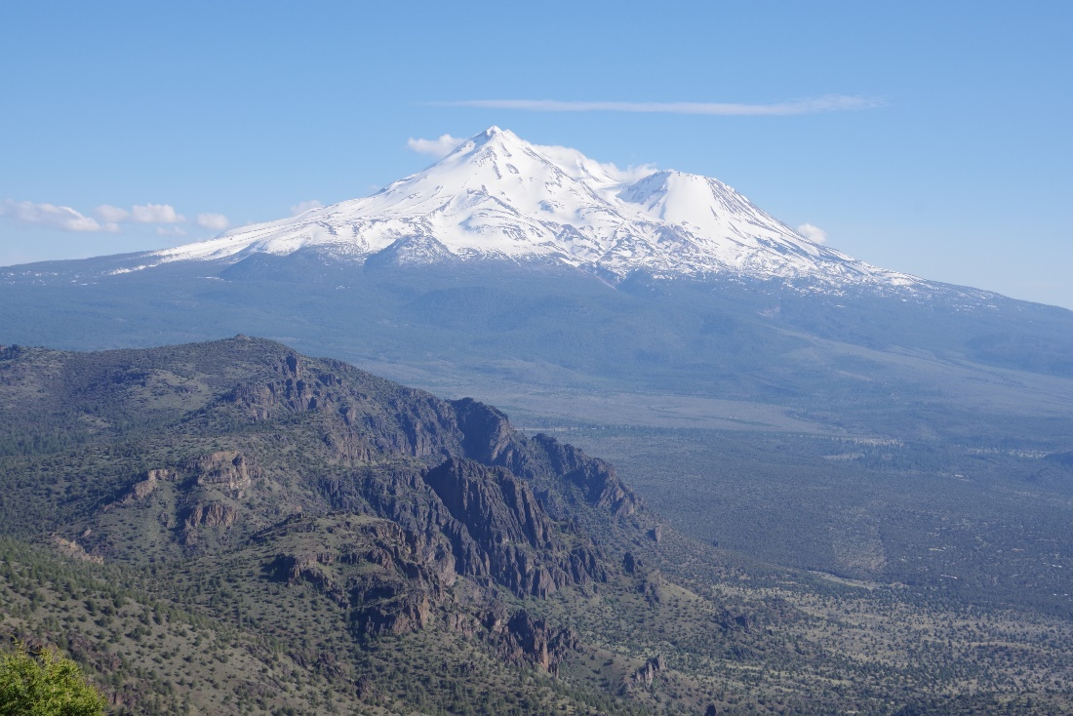
Questions?

